Slide 1
DIJKSTRA ALGORITHM
PRAJWAL THAKURI
LC00017000801

Slide 2
CONTENT
INTRODUCTION
HISTORY
ALGORITHM AND APPLICATION
TIME COMPLEXITY
EXAMPLE

Slide 3
INTRODUCTION
It is an algorithm for finding the shortest path between nodes in a graph, which may represent such as road networks.
The algorithm exists in many variants. Dijkstra's original algorithm found the shortest path between two given nodes, but a more common variant fixes a single node as the "source" node and finds shortest paths from the source to all other nodes in the graph, producing a shortest-path tree.
It is also call as greedy algorithm because you always mark the closest vertex.

Slide 4
HISTORY
A Dutch computer scientist, Edsger Dijkstra, in 1959, proposed an algorithm that can be applied to a weighted graph. The graph can either be directed or undirected with the condition that the graph needs to embrace a non-negative value on its every edge. He named this algorithm “Dijkstra's Algorithm” at his name.

Slide 5
ALGORITHM AND APPLICATION
Dijkstra's algorithm allows us to find the shortest path between any two vertices of a graph.
It differs from the minimum spanning tree because the shortest distance between two vertices might not include all the vertices of the graph.
APPLICATION
To find the shortest path
In social networking applications
In a telephone network
To find the locations in the map

Slide 6
TIME COMPLEXITY
Time Complexity of Dijkstra's Algorithm is O ( V 2 ) but with min-priority queue it drops down to O ( V + E l o g V ).
Dijkstra's algorithm is used for our fastest path algorithm because it can find the shortest path between vertices in the graph.

Slide 7
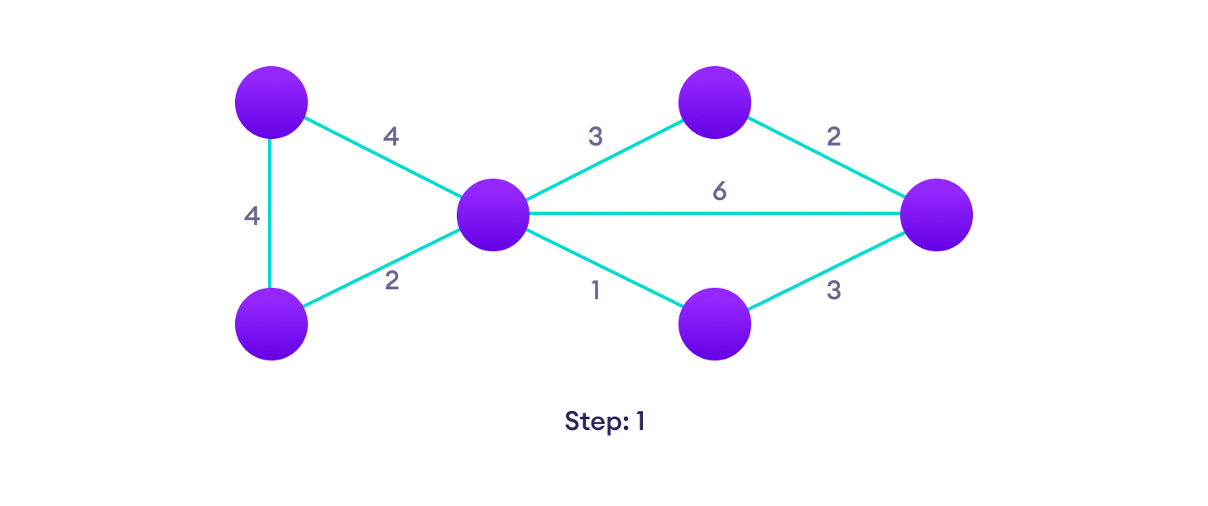
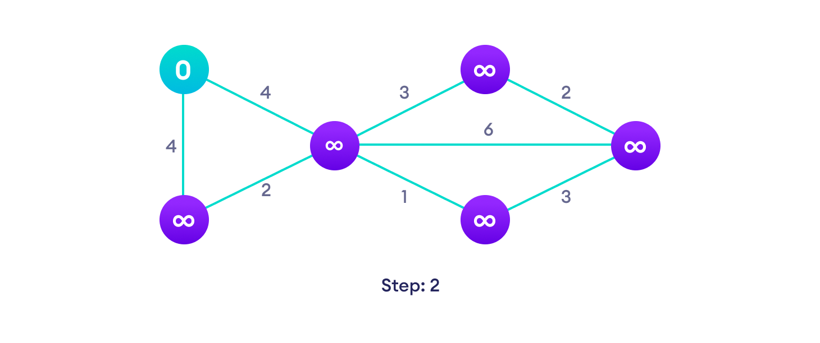
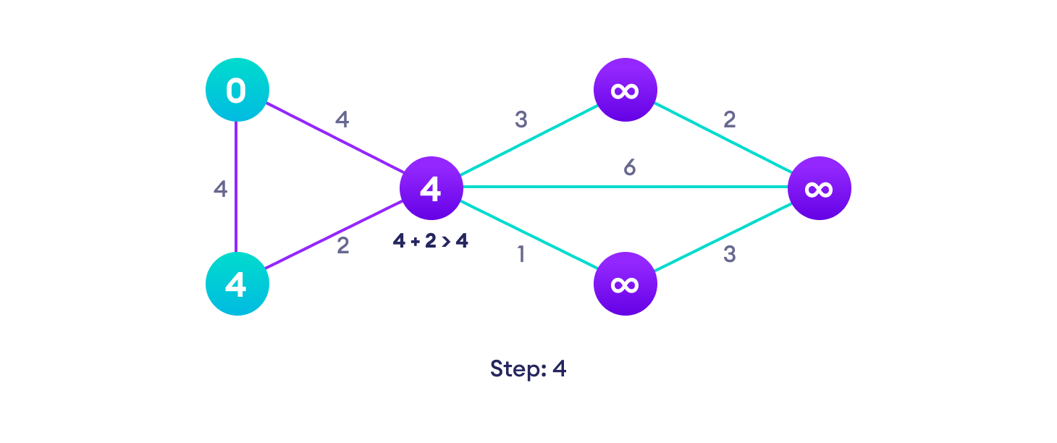
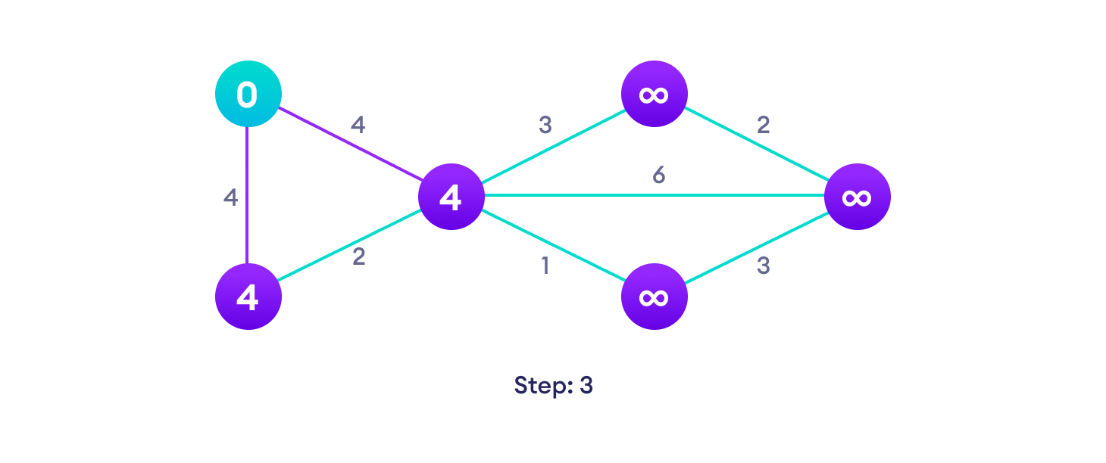
EXAMPLE
It is easier to start with an example and then understand about the algorithm.
Start with a weighted graph Choose a starting vertex and assign infinity path values to all other devices
Go to each vertex and update its path length If the path length of the adjacent vertex is lesser than new path length, don't update it

Slide 8
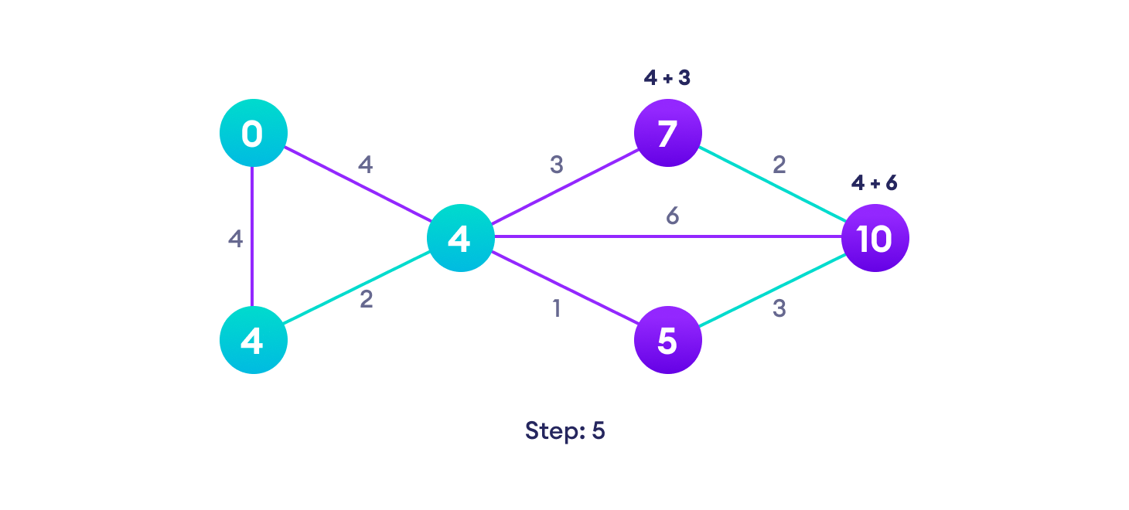
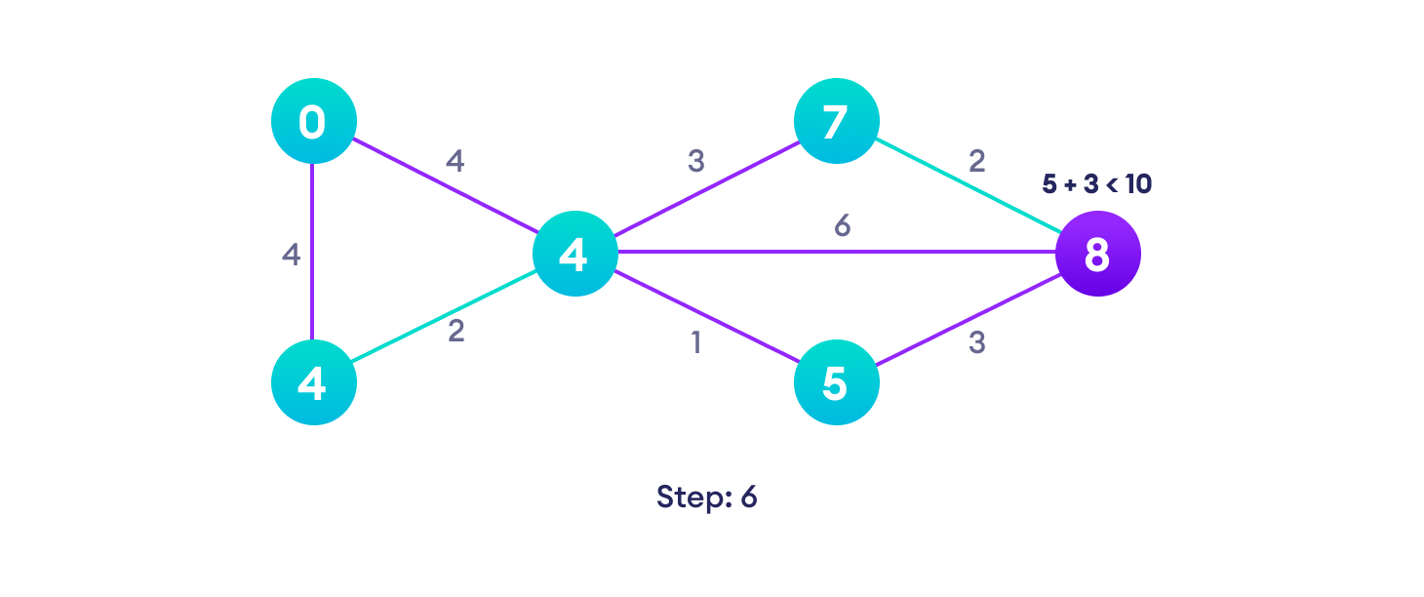
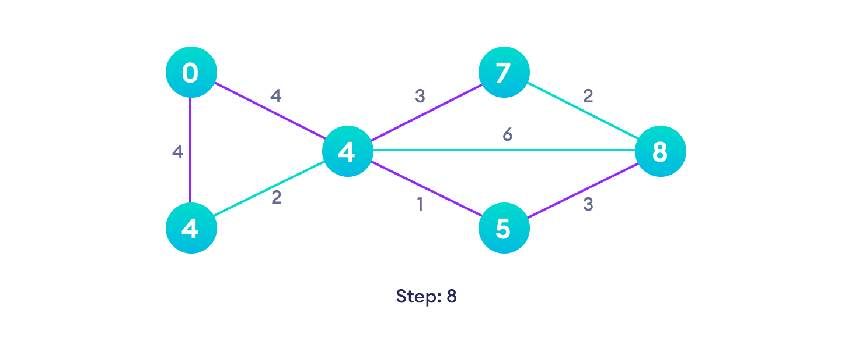
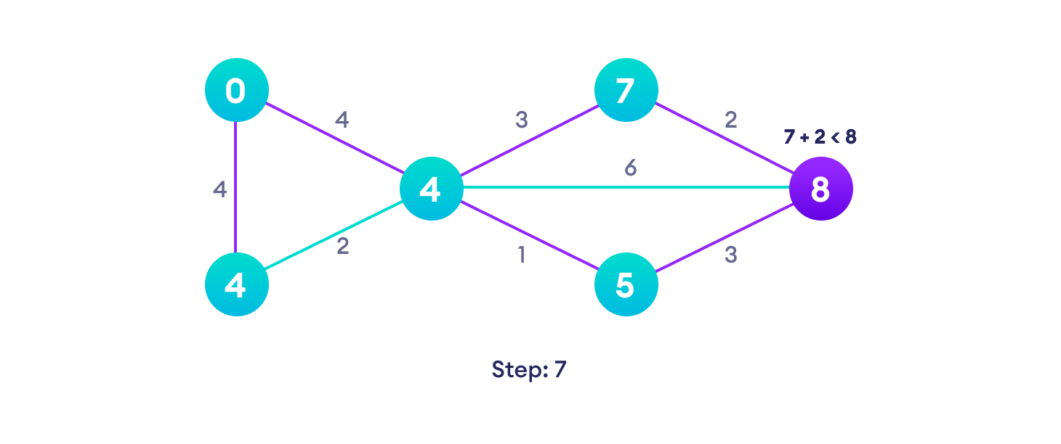
Avoid updating path lengths of already visited vertices After each iteration, we pick the unvisited vertex with the least
path length. So we choose 5 before 7
Notice how the rightmost vertex has its path length updated twice Repeat until all the vertices have been visited

Slide 9


